Slide 1
Input Validation
1. Introduction

Slide 2
Input Errors (will cause Incorrect Results)
Example 1: $1 Billion typing error
In 2005, a Japanese securities trader mistakenly sold 600,000 shares of stock at 1 yen each
Trader wanted to sell each share for 600,000 yen!
Example 2: $100,000 typing error
A Norwegian woman mistyped her account number by adding an extra digit to her 11-digit account number. The system discarded the extra digit, and transferred $100,000 to the (incorrect) account.
Both of these errors were preventable by simple input validation checks!
Example 1: Check price >= minimum price per share
Example 2: Check account number has correct number of digits

Slide 3
Input Errors (will cause Security Vulnerabilities)
Input errors can be caused by
Accidental mistakes by trusted users
Malicious users looking to take advantage of flaws in a system
Malicious user
One who intentionally crafts input data to cause programs to run unauthorized logic/commands
Discuss
How can a malicious person take advantage of input errors from previous slide?

Slide 4
Attacks using Malicious Input Data
Credit cards stolen
In Feb 2002, Jeremiah Jacks discovered that Guess.com had a vulnerability
A properly-crafted URL allowed anyone to pull down 200,000+ names, credit card numbers and expiration dates on the site's customer database
Known as a SQL-Injection attack
The attack is carried out for example by entering in a SQL command into a search box

Slide 5
SQL Injection Attack
Comic by XKCD

Slide 6
Summary
Programs often use external data
Source of this data may be
User input via keyboard
A data file
A database
Data that comes over a network
All external data that can enter your program is a potential source of problems
Using external data without validation can result in your system:
Producing incorrect results
Having security vulnerabilities that may be discovered by a malicious user

Slide 7
Common ways to Validate Input Data
Range check (reasonableness check)
Numbers checked to ensure they are within a range of possible values
Example
Value for month should lie between 1 and 12, inclusive
Length check
Ensure input is of appropriate length
Examples
US telephone number has 10 digits
Bank account numbers are 11 digits long
Type check
Input should be checked to ensure it is the data type expected
Example
Age must be an integer value
Format check
Check that data is in a specified format (template)
Example
Dates might be required to be in the format DD/MM/YYYY
Arithmetic Errors
Variables are checked for values that might cause problems
Example
Division by zero or integer overflow

Slide 8
What to do if Input Data has Errors?
When input errors are detected, program should immediately reject request
Do not attempt to interpret erroneous input into a correct one
Why?
Malicious user can craft input in a way so that corrected version is an attack
Use “deny-by-default” design principal
Anything not explicitly permitted is forbidden

Slide 9
Input Validation
2. Selection Statements

Slide 10
Body Mass Index: Types of Input Validation
Problem Statement
Write a program that allows the user to enter their weight and height and displays their Body Mass Index (BMI) category
Which types of input validation should our Split Bill solution be doing?
Type check
Both weight and height should be an integer
Range check (reasonableness check)
weight in range (0, 1000]
height in range (0, 100]
Arithmetic Errors
height cannot be 0 (avoid divide-by-zero)

Slide 11
Body Mass Index: Types of Input Validation (Solutions)
Review Solutions
Solution that does not use functions
2-BMI-Mainonly.py
Solution that uses functions
2-BMI-Functions.py

Slide 12
Split Bill: Types of Input Validation? (Class Discussion)
Problem Statement
A large party at a restaurant wants to split the bill evenly n ways, where n is the number of people in the party
Which types of input validation should our Split Bill solution be doing?
Range check (reasonableness check)
Numbers checked to ensure they are within a range of possible values
Length check
Ensure input is of appropriate length
Type check
Input should be checked to ensure it is the data type expected
Format check
Check that data is in a specified format (template)
Arithmetic Errors
Variables are checked for values that might cause problems

Slide 13
Split Bill: Types of Input Validation?
Problem Statement
A large party at a restaurant wants to split the bill evenly n ways, where n is the number of people in the party
Which types of input validation should our Split Bill solution be doing?
Range check (reasonableness check)
n > 0
n <= max-capacity-of-restaurant
bill-amount > 0
bill-amount < ?????
What is a reasonable upper limit?
Type check
n should be an integer
bill-amount should be a number
Arithmetic Errors
n cannot be 0 (avoid divide-by-zero)
Optional: Have students develop selection statements for each type of input validation listed above, then discuss in class.

Slide 14
Input Validation
3. Iteration Statements

Slide 15
Body Mass Index: Types of Input Validation (review)
Problem Statement
Write a program that allows the user to enter their weight and height and displays their Body Mass Index (BMI) category
Which types of input validation should our Split Bill solution be doing?
Type check
Both weight and height should be an integer
Range check (reasonableness check)
weight in range (0, 1000]
height in range (0, 100]
Arithmetic Errors
height cannot be 0 (avoid divide-by-zero)

Slide 16
Body Mass Index: Types of Input Validation (Solutions)
Use iteration to force entry of valid input data
Instead of terminating program as soon as one bad input is entered
Review Solutions
Solution that does not use functions
3-BMI-Mainonly.py
Solution that uses functions
3-BMI-Functions.py

Slide 17
Split Bill: Types of Input Validation? (review)
Problem Statement
A large party at a restaurant wants to split the bill evenly n ways, where n is the number of people in the party
Which types of input validation should our Split Bill solution be doing?
Range check (reasonableness check)
n > 0
n <= max-capacity-of-restaurant
bill-amount > 0
bill-amount < ?????
What is a reasonable upper limit?
Type check
n should be an integer
bill-amount should be a number
Arithmetic Errors
n cannot be 0 (avoid divide-by-zero)
Optional: Have students develop selection & iteration statements for each type of input validation listed above, then discuss in class.

Slide 18
Input Validation
4. Exceptions

Slide 19
Body Mass Index: Types of Input Validation (review)
Problem Statement
Write a program that allows the user to enter their weight and height and displays their Body Mass Index (BMI) category
Which types of input validation should our Split Bill solution be doing?
Type check
Both weight and height should be an integer
Range check (reasonableness check)
weight in range (0, 1000]
height in range (0, 100]
Arithmetic Errors
height cannot be 0 (avoid divide-by-zero)
Which of these input validation checks could be done via a try-except logic?

Slide 20
Body Mass Index: Types of Input Validation (Solutions)
Catch Use iteration to force entry of valid input data
Instead of terminating program as soon as one bad input is entered
Review Solutions
Solution that does not use functions
4-BMI-Mainonly.py
Solution that uses functions
4-BMI-Functions.py

Slide 21
Split Bill: Types of Input Validation? (review)
Problem Statement
A large party at a restaurant wants to split the bill evenly n ways, where n is the number of people in the party
Which types of input validation should our Split Bill solution be doing?
Range check (reasonableness check)
n > 0
n <= max-capacity-of-restaurant
bill-amount > 0
bill-amount < ?????
What is a reasonable upper limit?
Type check
n should be an integer
bill-amount should be a number
Arithmetic Errors
n cannot be 0 (avoid divide-by-zero)
Optional: Have students develop selection, iteration, and exception handling statements for each type of input validation listed above, then discuss in class.

Slide 22
Input Validation
5. Review

Slide 23
Use problem statement
Where input validation is needed but is not explicitly mentioned in the problem statement
Either
Do and discuss as an in-class exercise
Assign as an assignment or lab

Slide 24
Input Validation
6. Connections

Slide 25
In-class Discussion
How does input validation balance the security goals of Confidentiality, Integrity and Availability?
Input validation improves data integrity
i.e., it validates user inputs
When an input error is detected and deny-by-default design principal is implemented in program
User is told that they have invalid data
Either
They are denied access (app is not available)
Or are told to reenter the data (app decreases availability since input must be reentered)

Slide 26
In-class Discussion (cont’d)
How does input validation relate to the security concepts of Assurance, Authenticity and Anonymity?
Input validation increases and supports assurance of system's data
By validating data
App demonstrates to user that data is sensible
User builds trust in app since bad data not allowed to be processed

Slide 27
Input Validation
7. Throwing Exceptions

Slide 28
tbd

Slide 29
Input Validation
“Split Bill” Problem Sample Code Slides

Slide 30
Problem Statement: Split Bill
A large party at a restaurant wants to split the bill evenly n ways, where n is the number of people in the party
Assumptions
Amount of bill must be in range [1,2000]
Size of the party (n) must be in range [1,20]
Amount of tip must be in range [1,50]

Slide 31
Input Validation on Split Bill
def splitbill():
bill = getinput("Enter a bill amount [1,2000] ", 2000)
party = getinput("Enter your party size [1, 20] ", 20)
tip = getinput("Enter your tip amount [1,50] ", 50)
tip = setmintip(tip, party)
total = gettotal(bill, tip)
def getinput(msg, bound):
num = int(input(msg))
while num <1 or num > bound:
num = int(input(msg))
return num

Slide 32
Types of Input Validation done in Split Bill code
Range check (reasonableness check)
Numbers checked to ensure they are within a range of possible values
1 <= Bill <= 2000 1 <= party size <= 20
Length check
Ensure input is of appropriate length
Does not apply
Type check
Input should be checked to ensure it is the data type expected
Bill, party size, & tip should all be integers
Format check
Check that the data is in a specified format (template)
Does not apply
Arithmetic Errors
Variables are checked for values that might cause problems such as
Party size cannot be 0 (range check takes care of this)

Slide 33
Types of Input Validation done in Split Bill code
Split Bill code currently does not do type checking
Range check (reasonableness check)
Numbers checked to ensure they are within a range of possible values
1 <= Bill <= 2000 1 <= party size <= 20
Length check
Ensure input is of appropriate length
Does not apply
Type check
Input should be checked to ensure it is the data type expected
Bill, party size, & tip should all be integers
Format check
Check that the data is in a specified format (template)
Does not apply
Arithmetic Errors
Variables are checked for values that might cause problems such as
Party size cannot be 0 (range check takes care of this)

Slide 34
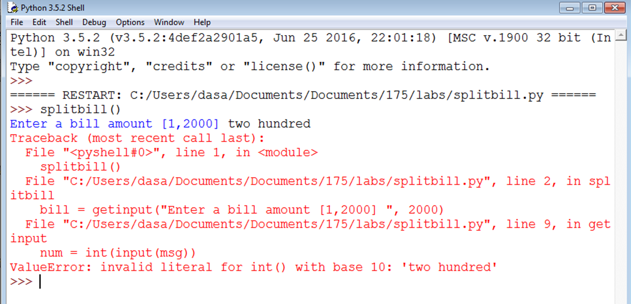
Split Bill code: No Type Checking
Need to prevent incorrect type of data from causing an Exception!

Slide 35
Revised Split Bill Code: Type checking
Original Code
def getinput(msg, bound):
num = int(input(msg))
while num <1 or num > bound:
num = int(input(msg))
return num
Revised Code
If a non integer is entered, python throws a ValueError
def getinput(msg, bound):
while True:
try:
num = int(input(msg))
if num >= 1 and num <= bound:
return num
except ValueError:
range = "[1," + str(num) + "]"
print("Only integers in", range, "allowed.")

Slide 36
In-class Discussion
What input validations are needed for following problem statement?
Ask user to enter their weight, height, and zip code. Output their BMI value along with the average BMI in their zip code.
Range check (reasonableness check)
108 (inches) > Height > 0, 1000 > weight > 0
Length check (ensure input is of appropriate length)
Read in ZIPCODE as a string and ensure it is 5 characters long
Type check (input checked to ensure it is data type expected)
Weight, height should be numbers (floats probably)
Format check (check that data is in a specified format)
Does not apply
Arithmetic Errors
Height > 0

